Slide 1
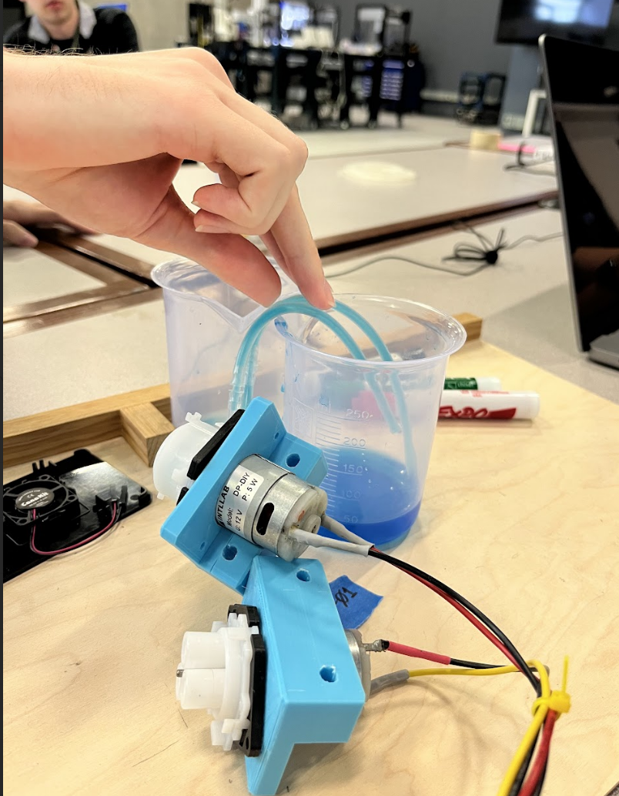
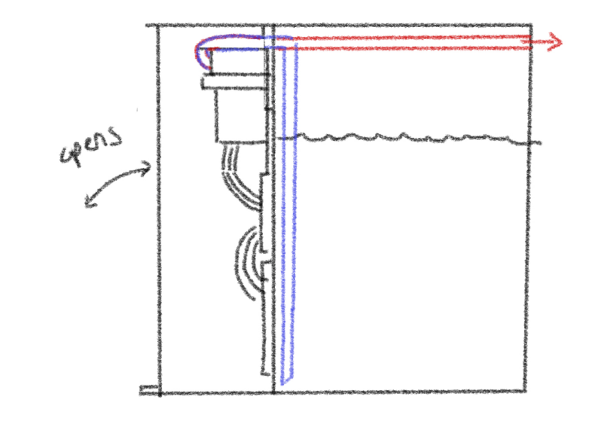
Aileen Cleary – 06/29/2023
Overall Goal: 1) Create an autonomous liquid refill system for Color Picker and 2) Write a program that dynamically visualizes (Color Picker’s) YAML files and experiment logs.
Weekly Goal: Begin coding Barty’s liquid refill system and designing his physical build.
Progress:
Fixed last week’s technical issues with Barty’s Raspberry Pi.
Received more materials for Barty (more pumps, servos, mounts).
Wrote and tested draft code for Barty’s liquid refill system.
Drafted ideas for the physical build.
Created a GitHub for Barty.
Challenges:
Had to replace Barty’s Raspberry Pi
Difficulty connecting to Pi/downloading packages/running code.
Permissions issues with GitHub.
Next Steps:
Create a buy list of parts for the physical build.
Polish draft of physical build.
Begin 3D modeling individual parts/entire build.
Start assembling Barty.
Continue working with Raf on the GitHub.

